Slide 1
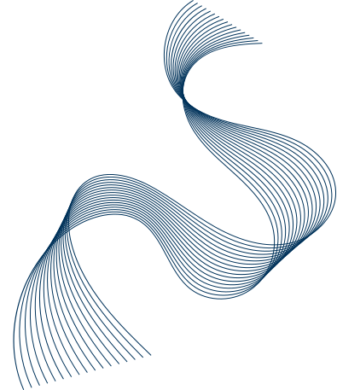


CSA0613-DESIGN AND ANALYSIS OF ALGORITHMS
MASTER THEOREM FOR NON-LINEAR RECURRENCE CONSIDER THE RECURRENCE RELATION T(N) 5T(N/2) + N².
CO1-ASSESSMENT TOOL 03-TECHNICAL PRESENTATION
PRESENTED BY
S.GAYATHERI
192521306
GUIDED BY
DR MARY HARIN FERNANDEZ F

Slide 2
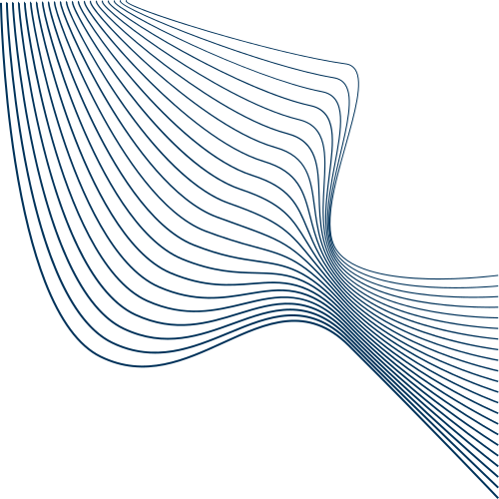
01
INTRODUCTION
Divide and Conquer algorithms use recurrence relations.
The Master Theorem helps solve these recurrences.
It determines the algorithm's time complexity.
This project analyzes T(n) = 5T(n/2) + n² using the Master Theorem.

Slide 3
02
PROBLEM STATEMENT
Analyzing recurrence relations manually is time-consuming and error-prone.
Identifying the correct Master Theorem case can be difficult for beginners.
This project focuses on analyzing the recurrence T(n) = 5T(n/2) + n².
The objective is to apply the Master Theorem to determine its time complexity.

Slide 4
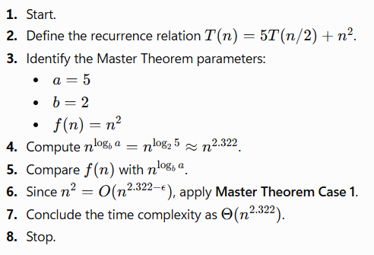
03
ALGORITHM &PSEUDO CODE
Algorithm MasterTheoremAnalysis()
Input: T(n) = 5T(n/2) + n²
Begin
a ← 5
b ← 2
f(n) ← n²
value ← log₂(5)
If f(n) < n^value Then
Output "Case 1 applies"
Output "Time Complexity = Θ(n^2.322)"
Else If f(n) = n^value Then
Output "Case 2 applies"
Else
Output "Case 3 applies"
End If
End

Slide 5
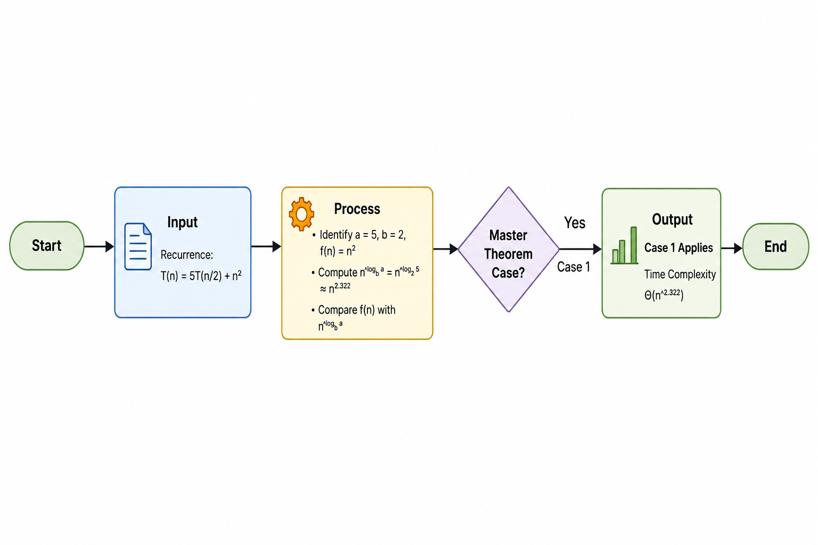
04
FLOWCHART

Slide 6
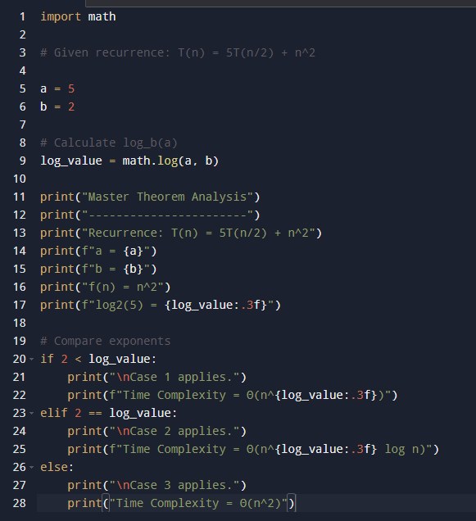
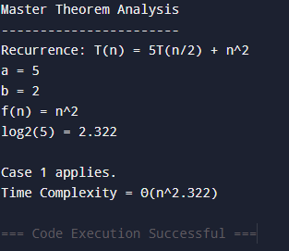
05
IMPLEMENTATION & OUTPUT

Slide 7
06
CONCLUSION
The recurrence relation T(n) = 5T(n/2) + n² was successfully analyzed using the Master Theorem.
By comparing f(n) = n² with n^log₂5 ≈ n²·³²², the recurrence satisfies Master Theorem Case 1.
The overall time complexity is Θ(n^2.322).
The analysis shows that the recursive subproblems dominate the total running time.

Slide 8
07
REFERENCES
Cormen, T. H., Leiserson, C. E., Rivest, R. L., & Stein, C. (2022). Introduction to Algorithms (4th Edition). MIT Press.
Kleinberg, J., & Tardos, É. (2006). Algorithm Design. Pearson Education.
Goodrich, M. T., Tamassia, R., & Goldwasser, M. H. (2014). Data Structures and Algorithms in Python. Wiley.
Weiss, M. A. (2013). Data Structures and Algorithm Analysis in C++ (4th Edition). Pearson.

Slide 9
08
THANK YOU

